Slide 1

Be Loyal
The Message of the Book of Hosea
Dr. Rick Griffith, Crossroads International Church Singapore
BibleStudyDownloads.org

Slide 2

Loyalty
Notes:
Loyalty has fallen on hard times. People aren’t very loyal anymore.
People switch jobs all the time.
We aren’t committed (loyal) to institutions.
We aren’t even committed (loyal) to our marriages.

Slide 3

Are you loyal?
Notes:
Are you loyal? What evidence can you marshal to defend yourself?

Slide 4

Loyal Relationships
Notes:
Do you show loyalty to others?

Slide 5

Are you loyal to God?
Notes:
Do you show loyalty to God?

Slide 6

How does God motivate us to be loyal to him?

Slide 7
Placing the Prophets
Placing the Prophets
342
Key Dates
931
Obadiah
722
Jonah
Amos
Hosea
Isaiah
Micah
586
Notes:
Israel hadn’t been very loyal for 200 years. Prophets who ministered at the same time as the beginning of Hosea’s preaching included Amos and Jonah.

Slide 8
Perils of Prosperity
592
 | Jonah | Amos | Hosea
Responsibility Addressed | Evangelistic | Social | Spiritual
Israel's Problem | Myopia | Injustice | Adultery
God's Attribute | Compassion | Justice | Faithfulness
Key Word | Compassion | Injustice | Loyal
Summary | God cares even for cruel Gentiles, so you should too! | God is fair with you, so you should be fair with others! | God is loyal to you, so be loyal to him.
Modern Parallels | Failure in Mission Responsibility | Oppression of Maids & Foreign Workers | Church's God is Modernity (Methods)
Date of Ministry (approx.) | 785-758 Beginning of Jeroboam's Reign | 767-753 Middle of Jeroboam's Reign | 755-710 End of Jeroboam's Reign
Notes:
The northern nation of Israel was in a period of prosperity.

Slide 9
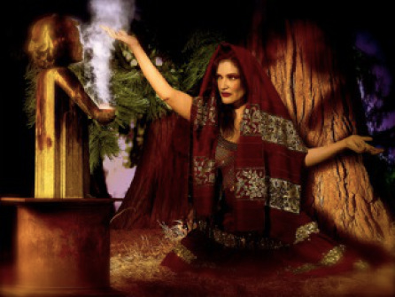
The Idolatry of Israel
Notes:
However, it also had a long history of idolatry. Finally, it was time to pay for their crimes against God, and Hosea acted as his messenger.

Slide 10

Amazing Love
Notes:
Hosea not only taught the message. His very life was the message, for his marriage pictured God’s “marriage” to Israel.

Slide 11

Amazing Love
Notes:
The context was one of flagrant immorality, yet Hosea showed the opposite in his unrelenting commitment to his wayward wife.

Slide 12
How does God motivate us to be loyal to him?
2 Ways
Notes:
Today we’ll see two ways God moves us to be loyal to him

Slide 13
Key Word
565
343
Loyal
Hosea
Notes:
The book of Hosea can be summed up in one word: loyalty. This is the Hebrew word hesed that refers to covenant love shown in keeping promises.

Slide 14
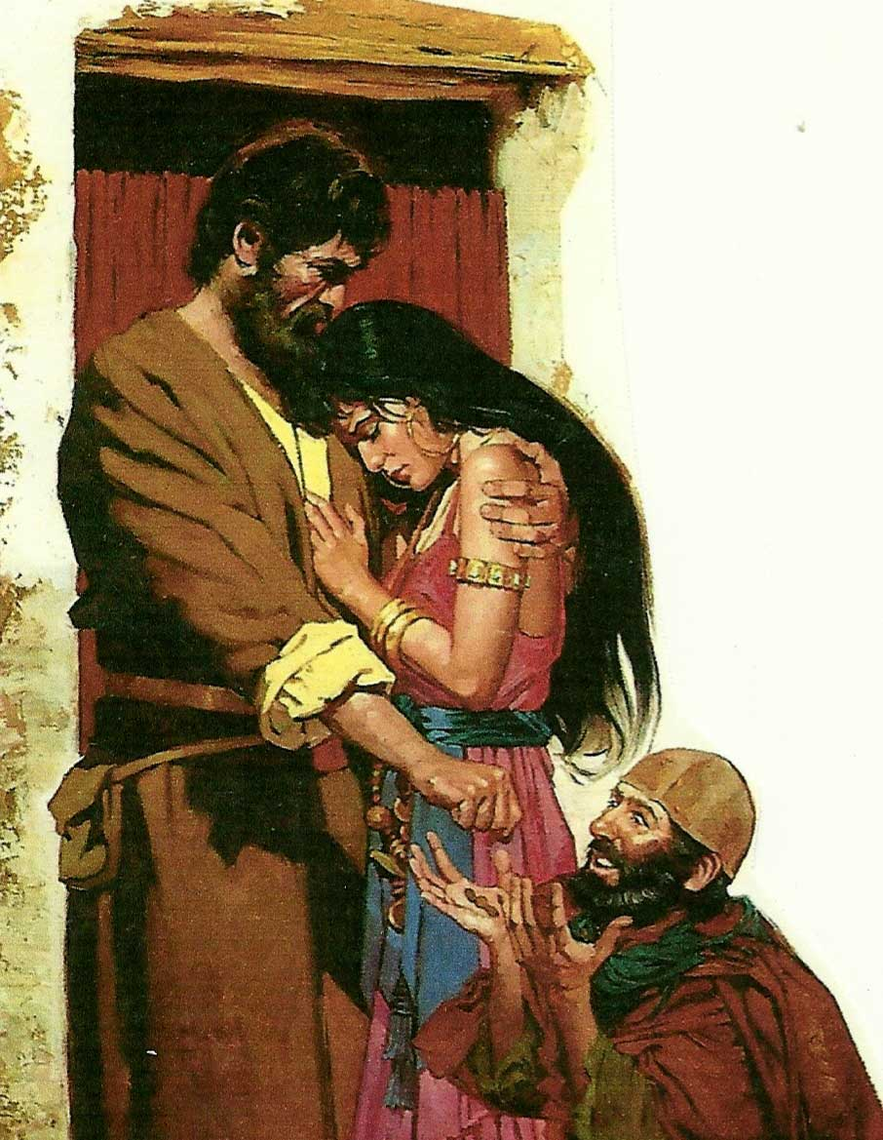
I. God motivates loyalty by examples.
Notes:
The LORD gives great illustrations of what it means to committed.

Slide 15
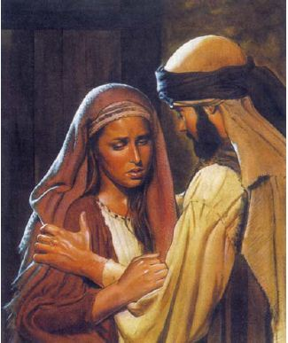
Hosea showed amazing loyalty in his failed marriage (Hosea 1–3).

Slide 16
Slides on
Hosea 1
Notes:
Hosea's adulterous wife Gomer bears three children before the Assyrian deportation who symbolize God's rejection of Israel, yet God promises restoration due to His commitment to the Abrahamic Covenant (1:1–2:1).

Slide 17

When Hosea Wrote (1:1)
453
Kings of Israel
Jeroboam
Pekah
Hoshea
Kings of Judah
Uzziah
Jotham
Ahaz
Hezekiah
Hosea's 45-Year Ministry
(755-710 BC)
Notes:
17
The date of the prophecy as a 45-year period before, during, and after the Assyrian deportation shows God's last minute warnings to His wayward people, Israel (1:1).

Slide 18

Hosea 1:2 NLT
"When the LORD first began speaking to Israel through Hosea, he said to him, 'Go and marry a prostitute, so that some of her children will be conceived in prostitution. This will illustrate how Israel has acted like a prostitute by turning against the LORD and worshiping other gods.'"
Notes:
Hosea obeys God's instructions to marry Gomer and she bears three children during her adultery who symbolize God's rejection of Israel and compassion on Judah (1:2-9).

Slide 19

Gomer took off for other lovers…
Notes:
Hosea obeys God's instructions to marry Gomer and while she is committing adultery…

Slide 20
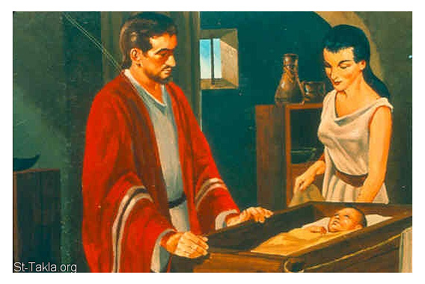
What about Gomer's children?
573
Notes:
While she is committing adultery they have children with strange names.

Slide 21
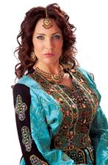
Gomer's Children
573
Text | Hosea 1:2-5 | Hosea 1:6-7 | Hosea 1:8
Name | Jezreel | Lo-Ruhamah | Lo-Ammi
Sex | Boy | Girl | Boy
Translation | "He [God] scatters" | "No compassion" | "Not My people"
Notes:
First is a son named "God scatters" to predict God's dispersion of the house of Jehu for his murder of Ahaziah and his relatives (1:2-5; cf. 2 Kings 9:27ff.).
Gomer then bears a daughter named "Not loved" to illustrate God's compassion upon Judah but His lack of compassion upon Israel (1:6-7).
Gomer finally bears a son named "Not my people" to illustrate God's rejection of the northern nation of Israel (1:8-9).

Slide 22
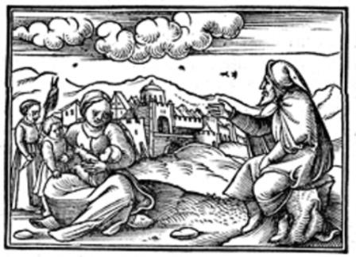
What about Gomer's children?
573
Notes:
Imagine calling your kinds such strnage names today!

Slide 23
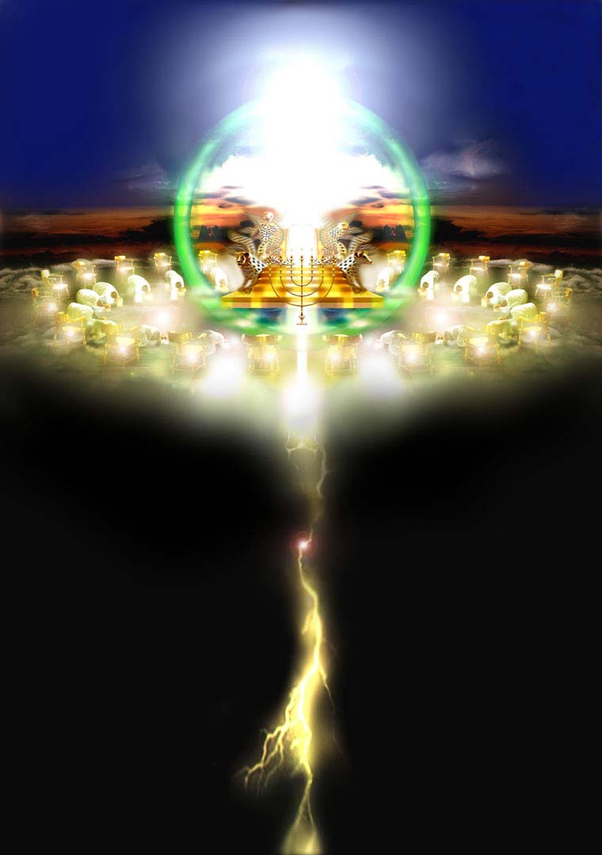
FUTURE SIGNIFICANCE OF HOSEA

Slide 24
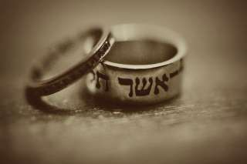
Israel's Future Restoration (1:10–2:1)
569
Despite God's discipline, God tells Hosea that He will eventually restore the nation in the following ways:
  Numerical growth (1:10a)
  Spiritual restoration (1:10b)
  National unification (1:11a)
  Civic centralization (1:11b)
  Territorial occupation (1:11c)
  Divine blessing (2:1)
These promises have not been fulfilled yet. Texts like these show God makes these types of promises about a literal future kingdom where Israel will occupy the land in peace and experience God's blessings. If you don't believe in a millennium, you have to ignore these passages or say that they have already been fulfilled in history or are going to be fulfilled in the church.
Notes:
God promises Israel a restored population, relationship, and land as His beloved people because of His faithfulness to the Abrahamic Covenant (1:10–2:1).

Slide 25
Slides on
Hosea 2
Notes:
God promises that Israel will once again be called His beloved people because of His faithfulness to the Abrahamic Covenant (2:1).

Slide 26
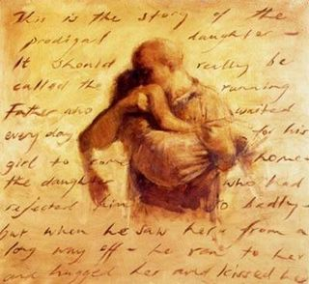
Hosea 2:1 NLT
"In that day you will call your brothers Ammi—‘My people.’ And you will call your sisters Ruhamah—‘The ones I love.’'"

Slide 27

Hosea 2:2-3 NLT
"But now bring charges against Israel
—your mother—
for she is no longer my wife,
and I am no longer her husband.
Tell her to remove the prostitute's makeup from her face
and the clothing that exposes her breasts.
³ Otherwise, I will strip her as naked
as she was on the day she was born.
I will leave her to die of thirst,
as in a dry and barren wilderness."

Slide 28

Did Hosea Divorce Gomer?
574
Notes:
Does God calling Israel “Not my people” and “she is not my wife” (2:2) mean Hosea divorced Gomer

Slide 29

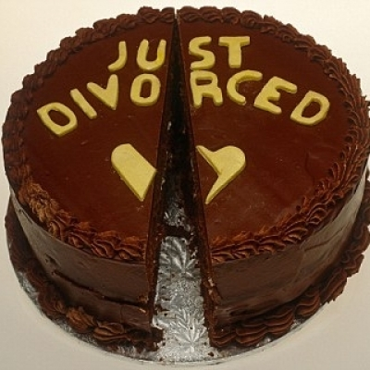
Arguments For & Against Hosea Divorcing Gomer
574
Notes:
I have a one-page study on this, but I will spare you the details and give a simple “No.”

Slide 30
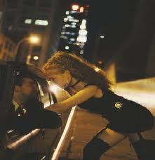
Hosea 2:5 NLT
"Their mother is a shameless prostitute and became pregnant in a shameful way. She said, 'I'll run after other lovers and sell myself to them for food and water, for clothing of wool and linen, and for olive oil and drinks.'"
Notes:
God does not minimize her sins.

Slide 31
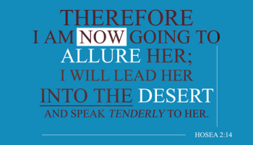
Hosea 2:14
Notes:
But God does discipline her and then bring her back.

Slide 32
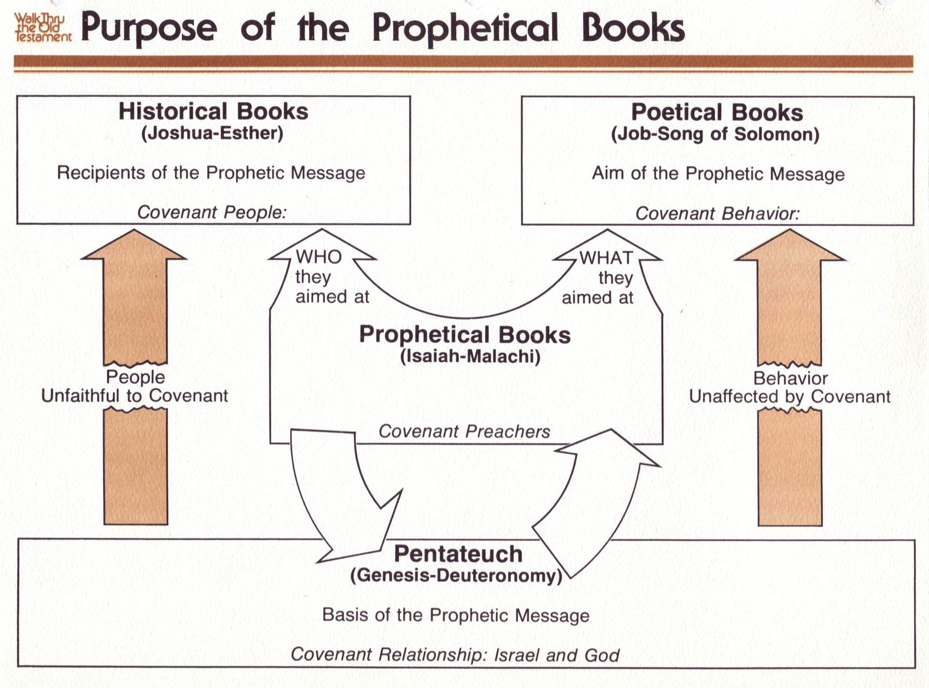
Purpose of the Prophetic Books
440
先知书的目的
122
Purpose of the Prophetic Books
历史书
(约书亚书-以斯帖)
先知信息的接受者
立约人
诗歌书
(约伯记 –雅歌)
先知信息的目的
约定行为
他们
的目标
是谁
他们
的目标
是什么
先知书
(以赛亚书 – 玛拉基书)
约传教士
人们不忠于
约定
行为没有受到
约定的影响
Mosaic Covenant
Abrahamic Covenant
摩西的约
摩西五经
(创世纪-申命记)
先知信息的依据
约定关系: 以色列与上帝
亚伯拉罕的约
Deut. 28; Lev. 26
Gen. 12:1-3; 15:18
创. 12:1-3; 15:18
申. 28; 利. 26
Conditional
Unconditional
有条件的
无条件的
Judgment
Blessing
审判
祝福
Notes:
We can only understand this text when we understand two covenants: the unconditional Abrahamic Covenant and the conditional Davidic Covenant.

Slide 33
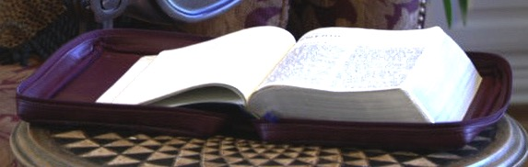
Literal * Eternal * Unconditional
Gen. 13:15; Gen. 15
7
Abrahamic Covenant
Gen. 12:1-3
LAND SEED BLESSING
ABRAHAM
The CALL
L - S - B
• LITERAL
• ETERNAL
• UNCONDITIONAL
Handbook pg. 19-24
16
3
Notes:
God’s strategy to woo Israel back to himself after they trust the Baals was to reject them, withhold their crops, and promise restoration due to His commitment to the Abrahamic Covenant (2:2-23).

Slide 34
Prophetic Curses
154
220
Why?
Exile
Deut. 28
Notes:
God’s formal legal accusation against the people of Israel for their idolatry (adultery) officially declares His temporary rejection of them as His people (2:2a).

Slide 35
Blessings & Curses
154
220
Deut. 28
Your towns and your fields
will be blessed (3)
Your towns and your fields
will be cursed (16)
Your children and your crops
will be blessed (4)
Your children and your crops
will be cursed (17)
Your fruit baskets and bread-boards will be blessed (5)
Your fruit baskets and bread-boards will be cursed (18)
Wherever you go and whatever you do, you will be blessed (6)
Wherever you go and whatever you do, you will be cursed (19)
Your enemies will attack you from one direction, but they will scatter from you in seven! (7)
You will attack your enemies from one direction, but you will scatter from them in seven! (25)
You will lend to many nations, but you will never need to borrow from them (12)
They will lend to money to you, but you will not lend to them
(44)
Notes:
God will make life difficult due to Israel’s idolatry (adultery) so the people would see that following God again is best (Hosea 2:2b-7).
God warns that since the nation trusted the Baals for their crops, He would destroy them that Israel might acknowledge His Lordship (Hosea 2:8-13).

Slide 36
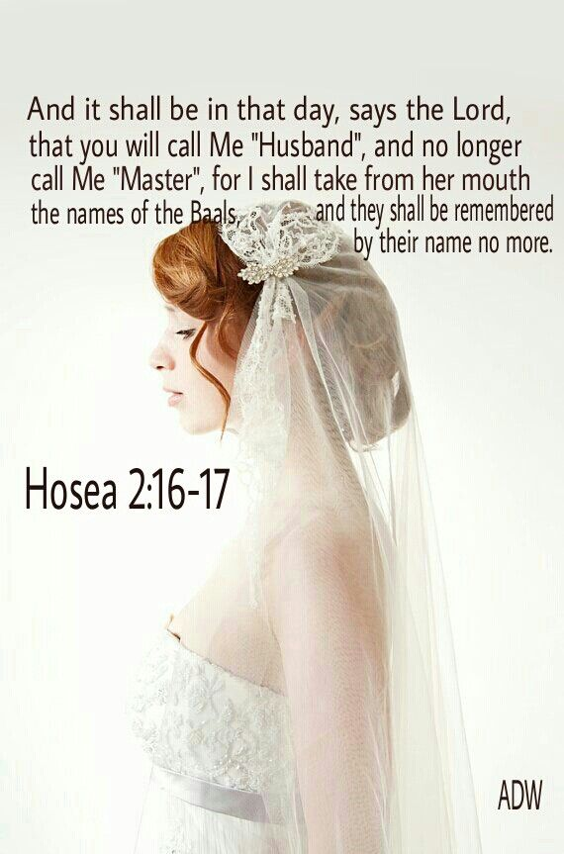
Hosea 2:16-17
Notes:
God promises to woo His "wife" Israel back to Himself again because of His commitment to the Abrahamic Covenant (2:14-20).
God promises to restore the covenant relationship with His faithless "wife" Israel because of His commitment to the Abrahamic Covenant (2:21-23).

Slide 37
Slides on
Hosea 3
Notes:
Hosea redeems Gomer from prostitution and quarantines her to depict God's future restoration of Israel after being away from the land (Hosea 3).

Slide 38
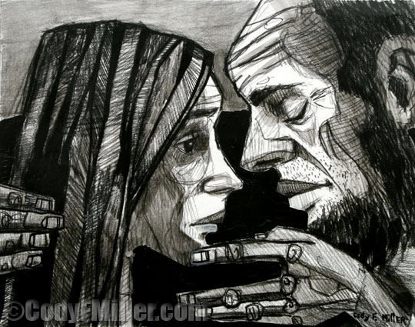
Restoration
Notes:
Hosea redeems Gomer from prostitution by paying her debts and quarantines her from other men (3:1-3).

Slide 39
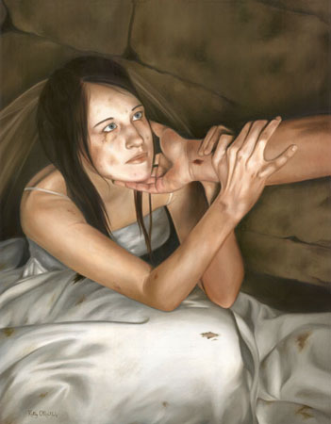
Hosea 3:1 NLT
"Then the LORD said to me, 'Go and love your wife again, even though she commits adultery with another lover. This will illustrate that the LORD still loves Israel, even though the people have turned to other gods and love to worship them.'"

Slide 40
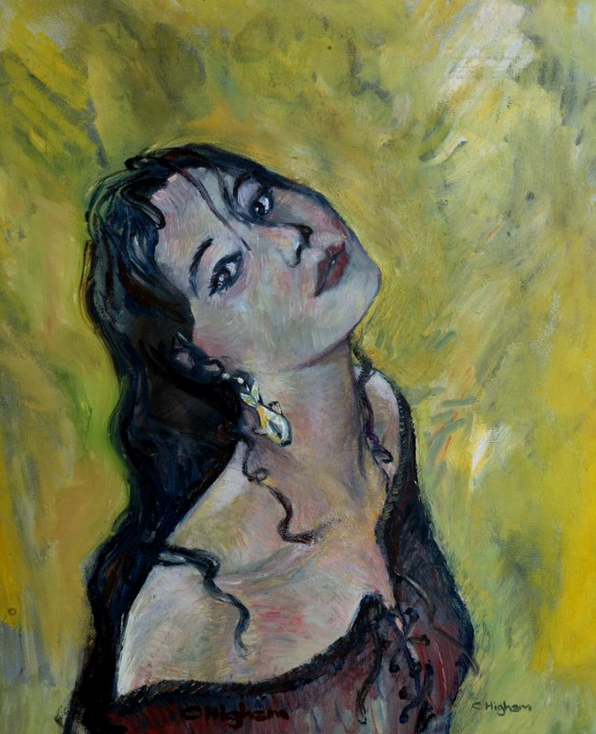
Hosea 3:2-3 NLT
"So I bought her back for fifteen pieces of silver and five bushels of barley and a measure of wine. ³Then I said to her, 'You must live in my house for many days and stop your prostitution. During this time, you will not have sexual relations with anyone, not even with me.'"

Slide 41
The Redemption Price
GOMER THE HARLOT
(Hos. 3:2)
ISRAEL THE HARLOT
(cp. Jer. 3:1-5)
15 Shekels of Silver
+ A Homer & a Half of Barley
Hosea 3:2
= 1 Unfaithful Gomer

Slide 42
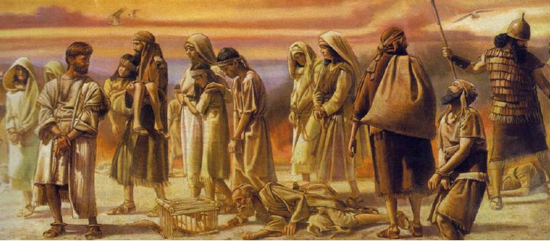
Hosea 3:4-5 NLT
"This shows that Israel will go a long time without a king or prince, and without sacrifices, sacred pillars, priests, or even idols! ⁵But afterward the people will return and devote themselves to the LORD their God and to David's descendant, their king. In the last days, they will tremble in awe of the LORD and of his goodness."
Notes:
Hosea redeems Gomer from prostitution by paying her debts and quarantines her from other men (3:1-3).

Slide 43

The Meaning of Hesed ds,x,
567
KJV: "lovingkindness," "mercy," "goodness"
Nelson Glueck (1927): "covenant loyalty"
Key Word for Hosea: Loyal
Key Verse for Hosea:
"At that time I will plant a crop of Israelites
and raise them for myself.
I will show love
to those I called 'Not loved.'
And to those I called 'Not my people,'
I will say, 'Now you are my people.'
And they will reply, 'You are our God!' " (2:23 NLT)
Notes:
Hosea uses a Hebrew equivalent for the English word “love” (hesed) six times in his short writing (2:19; 4:1; 6:4, 6; 10:12; 12:6 [7]). Other prophets use the same word, such as Isaiah (8 times) and Jeremiah (6 times), but Hosea uses this term more frequently than any other prophet (proportionally, considering his small book size).
What really does hesed mean? The KJV often translates it as “lovingkindness” (2:19) or “mercy” (4:1; 6:6; 10:12; 12:6) but sometimes “goodness” (6:4) and “kindness” (Joel 2:13). The NASB emphasizes these last two translations while the NIV agrees and adds the concept of acts of devotion, unfailing love, great love, unfailing kindness, favor, devout, faithful, grace, loyalty, approval, lovingkindness, and many other terms! It is an important term since it is used nearly 250 times in the OT.
What really does hesed mean? The KJV often translates it as “lovingkindness” (2:19) or “mercy” (4:1; 6:6; 10:12; 12:6) but sometimes “goodness” (6:4) and “kindness” (Joel 2:13). The NASB emphasizes these last two translations while the NIV agrees and adds the concept of acts of devotion, unfailing love, great love, unfailing kindness, favor, devout, faithful, grace, loyalty, approval, lovingkindness, and many other terms! It is an important term since it is used nearly 250 times in the OT.

Slide 44
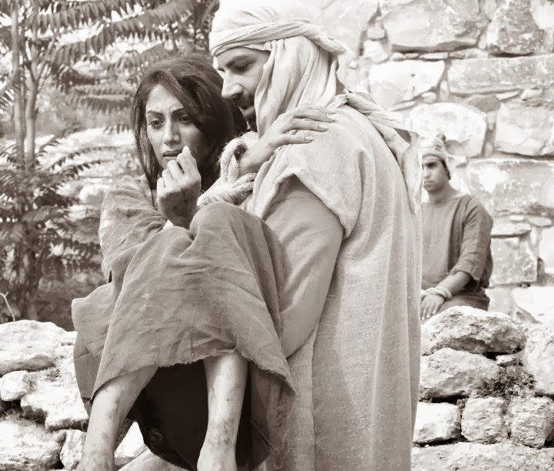
"Scripture" (6: NLT).
Notes:
My study of Hosea follows Glueck’s view that interprets the term as referring to covenant loyalty. In particular, the Mosaic Covenant is in view which obligates both God and Israel to certain requirements (cf. Exod. 19–20), including Israel’s blessings for obedience and curses for disobedience (Deut. 28). Therefore, God continues to show commitment and mercy towards the nation (based upon the Abrahamic Covenant) and Israel should respond by showing loyalty towards God by following the Mosaic stipulations.

Slide 45

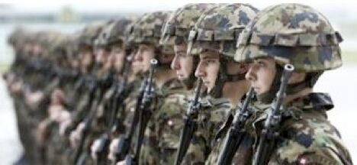
Others model God’s type of loyalty for us.
Notes:
We often feel that God owes us something because he hasn’t been loyal to us. Yet the opposite is true. We owe God everything because he actually has never once failed us!
He often shows that loyalty through significant people. Who has been the best example of loyalty to you in your own life? Your mother? Your father? Your spouse?
Let that person exemplify God’s loyalty to you! Then show that same loyalty to him.

Slide 46
I. God motivates loyalty by examples.

Slide 47

Hosea: God's Loyalty to Israel
565
Unfaithful Gomer | Unfaithful Israel
Faithful Hosea | Faithful LORD
Marriage of Hosea | Message of Hosea
Personal | National
Chapters 1–3 | Chapters 4–14

Slide 48

II. God motivates loyalty by balancing correction and blessings.
Notes:
The LORD pairs his penalties with his gifts.
God is loyal to Israel by both discipline and restoration (Hosea 4–14).

Slide 49
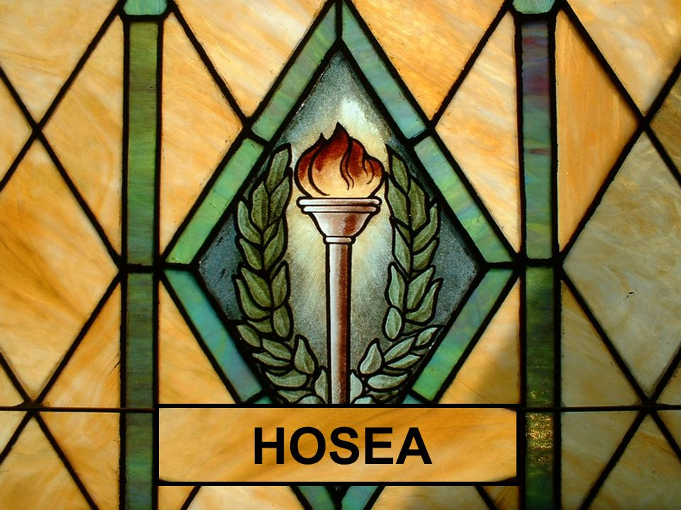
He punished Israel as he promised in his covenant with Moses (Hosea 4–13).

Slide 50
Slides on
Hosea 4

Slide 51

"Hear the word of the LORD,
O people of Israel!
The LORD has brought charges against you, saying:
'There is no faithfulness, no kindness (hesed), no knowledge of God in your land"
(Hosea 4:1 NLT).
4:4–6:3
6:4–11:11
11:12–13:16
Notes:
God’s lawsuit against Israel (4:1-3) promises judgment for lacking covenantal knowledge of God (4:4–6:3), loving loyalty (6:4–11:11), and faithfulness (11:12–13:16).

Slide 52
"Hear the word of the LORD,
O people of Israel!
The LORD has brought charges against you, saying:
'There is no faithfulness, no kindness (hesed), no knowledge of God in your land"
(Hosea 4:1 NLT).
4:4–6:3
Notes:
God will judge Israel and Judah for lack of spiritual knowledge, resulting in prostitution and idolatry, but promises to accept them when they repent (4:4–6:3).

Slide 53
Parallels with the Ten Commandments
HOSEA 4:2
Ten Commandments
(Exodus 20)
Lying
Murder
Stealing
Adultery
Commandment 9 (20:16)
Commandment 6 (20:13)
Commandment 8 (20:15)
Commandment 7 (20:14)

Slide 54
Slides on
Hosea 5

Slide 55
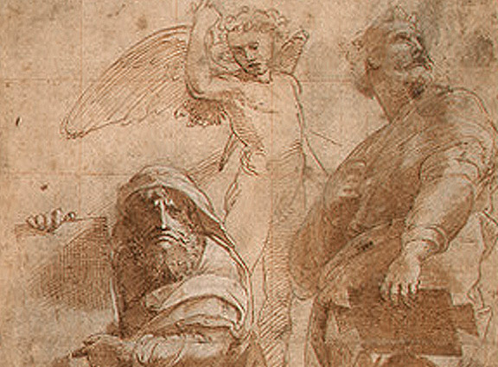
PSYCHOLOGICAL DOWNSPIRAL (5:4-15)
"Their pride will not permit them to return to the LORD" (5:4)
"When they seek the LORD, they will not find him" (5:6)
God said that He will go back to His place "until they admit their guilt" (5:15a)
Notes:
Lack of knowledge in both Judah and Israel prevents them from repenting of prostitution and idolatry, but God promises that they will eventually repent and seek Him (Hosea 5).

Slide 56
Slides on
Hosea 6

Slide 57
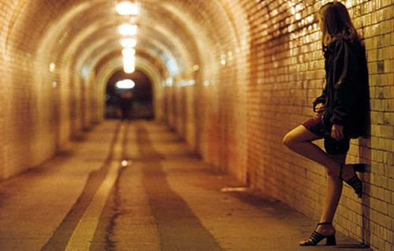
Israel went after other lovers instead of knowing her true husband, the LORD

Slide 58
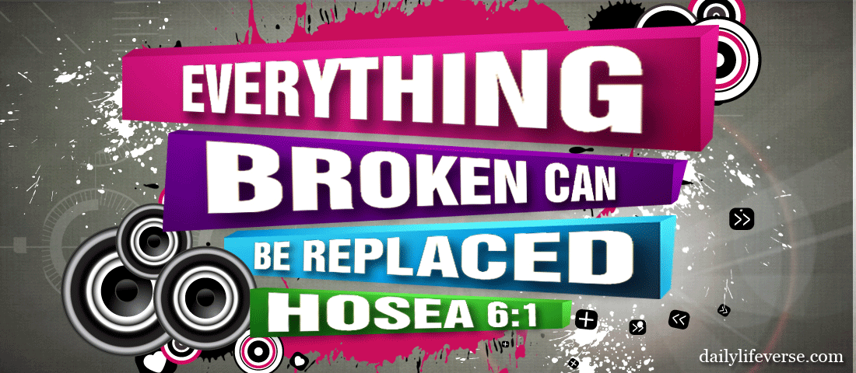
"Come, let us return to the LORD. He has torn us to pieces but he will heal us"
(Hosea 6:1 NLT).
Notes:
Hosea encourages the nation to repent because of God's willingness to accept them back (6:1-3).

Slide 59
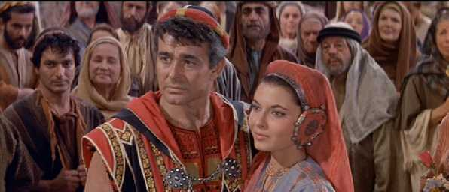
Eschatological Significance - Hosea 6:1-3
One of the several promises of restoration
God will never completely and finally destroy his people
A remnant will remain, rescued from exile
Passage not limited to OT––Restoration finds partial fulfillment in NT
In essence, it is an invitation to (re)acceptance by God of a people (note that the language here is plural and corporate, not singular and individual)

Slide 60
"Hear the word of the LORD,
O people of Israel!
The LORD has brought charges against you, saying:
'There is no faithfulness, no kindness (hesed), no knowledge of God in your land"
(Hosea 4:1 NLT).
4:4–6:3
6:4–11:11

Slide 61
Slides on
Hosea 7

Slide 62
HOSEA 7 - Physician & Painter
MISSING THE TARGET!
Badness being exposed (7:1-3)
Bread baking in oven (7:4-8)
Before balding sets in (7:9-10)
Bird-brained sense! (7:11-14)
Bows bent - can't shoot straight! (7:15-16 cp. Ps 78:57)

Slide 63
Believers today commit spiritual adultery by compromising with atheists
So how do Christians miss the target today?

Slide 64
Slides on
Hosea 10
Notes:
God compares Israel with a luxuriant vine, trained heifer, and loved son to illustrate the nation's idolatry and wickedness instead of loving loyalty (10:1–11:11).

Slide 65

Hosea 10:1 NLT
"But the richer
the people get,
the more pagan altars they build.
The more bountiful their harvests,
the more beautiful their sacred pillars."
"How prosperous Israel is—
a luxuriant vine loaded with fruit."
Notes:
God compares Israel with a luxuriant vine that credits idolatry for it prosperity and as a result became increasingly faithless (10:1-10).

Slide 66
Slides on
Hosea 11
Notes:
God compares Israel with a loved son whose father could not reject despite his idolatry and murder (11:1-11).

Slide 67
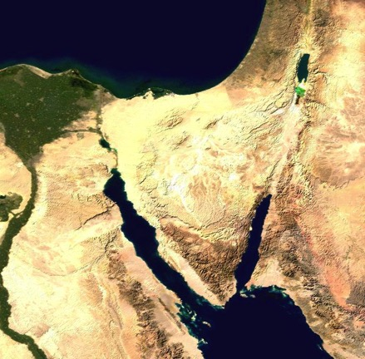
Case Study:
Hosea 11:1 in Matthew 2:15
Who does "son" refer to in each passage?
What difference does this make?
What is Matthew's message for us?
Is it faithful to the OT context and message?
Israel
(Hos. 11:1)
Jesus
(Matt. 2:15)

Slide 68
Case Study:
Hosea 11:1 in Matthew 2:15
Hosea called Israel God's "son," but Israel was a disobedient son.
Matthew calls Jesus God's Son, but He is an obedient Son. Unlike Israel, Jesus was perfect in every instance where Israel failed.
Israel
(Hos. 11:1)
Jesus
(Matt. 2:15)

Slide 69
"Hear the word of the LORD,
O people of Israel!
The LORD has brought charges against you, saying:
'There is no faithfulness, no kindness (hesed), no knowledge of God in your land"
(Hosea 4:1 NLT).
4:4–6:3
6:4–11:11
11:12–13:16

Slide 70
Slides on
Hosea 13
Notes:
God warns that the people's unfaithfulness to the covenant seen in its false worship throughout its history will result in a coming destruction (Hosea 13).

Slide 71
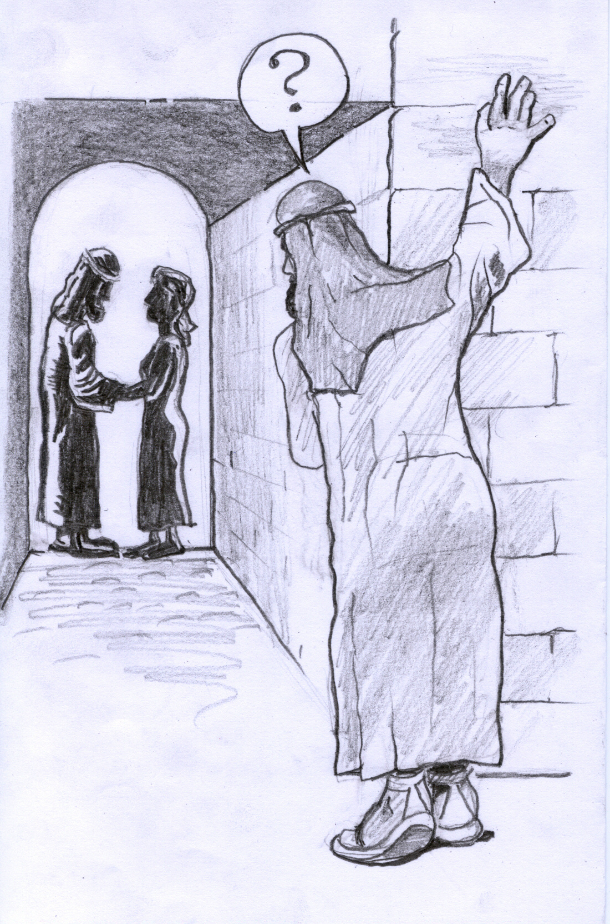
"The people of Samaria must bear the consequences of their guilt because they rebelled against their God"
(Hosea 13:16 NLT).

Slide 72
Slides on
Hosea 14
Notes:
He will bless Israel as he promised in his covenant with Abraham (Hosea 14).
The nation must repent and turn to Him rather than to idols or alliances (14:1-3).
God promises to heal Israel's apostasy and make the nation fruitful again (14:4-7).
Since He alone provides prosperity, there is no value in clinging to idols (14:8).
The wise and righteous who understand the prophecy must obey the ways of the LORD (14:9).

Slide 73

God balances discipline with blessings today too!
HOSEA
FROM BROKEN TO BRAND NEW

Slide 74

FROM BROKEN
Notes:
He disciplines us like a loving father. Hebrews 12 reminds us of his discipline.

Slide 75

TO BRAND NEW
Notes:
He disciplines us like a loving father. Hebrews 12 reminds us of his discipline.

Slide 76
God balances discipline with blessings today too!
HOSEA
FROM BROKEN TO BRAND NEW

Slide 77
How does God motivate us to be loyal to him?
Notes:
So how does God motivate us to be loyal to him? It’s none other than his own loyalty first!

Slide 78

Main Idea
God is loyal to you,
so be loyal to him
Hosea

Slide 79
Simply put...
565
343
Be Loyal
Hosea
Notes:
He encourages us to be loyal to him by first being loyal to us (MI restated).

Slide 80
How does God motivate us to be loyal to him?
2 Ways

Slide 81
I. God motivates loyalty by examples.

Slide 82
II. God motivates loyalty by balancing correction and blessings.
Notes:
The LORD pairs his penalties with his gifts.

Slide 83
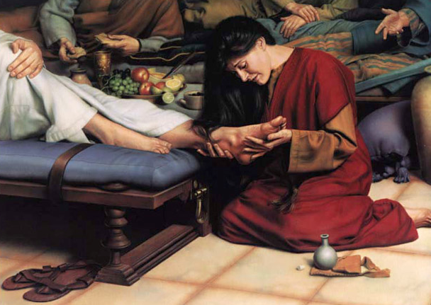
How are you doing at being loyal to your loyal Lord?
Notes:
Have you trusted him to take away your sin?

Slide 84
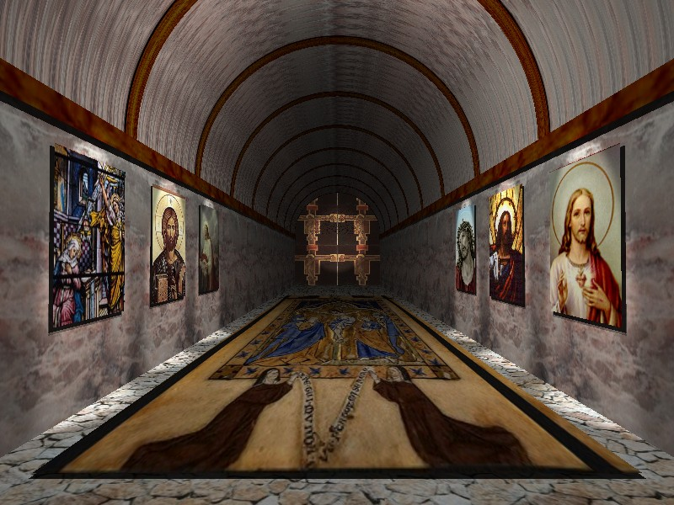

Revelation 2:4 (NIV)
"Yet I hold this against you:
You have forsaken
your first love."
Notes:
Perhaps you believe in Jesus, but you lost your first love. Are you resisting meeting with him?

Slide 85
1 John 2:15 (NIV)
"Do not love the world or anything in the world. If anyone loves the world, the love of the Father is not in him."
Notes:
My Heart, Christ’s Home is a story that depicts Jesus as occupying various rooms of a believer’s home—except those where he isn’t granted entrance.

Slide 86
1 John 2:16-17 (NIV)
"For everything in the world—the cravings of sinful man, the lust of his eyes and the boasting of what he has and does—comes not from the Father but from the world. The world and its desires pass away, but the man who does the will of God lives forever."

Slide 87
James 4:4 (NIV)
"You adulterous people, don't you know that friendship with the world is hatred toward God? Anyone who chooses to be a friend of the world becomes an enemy of God."

Slide 88
Black

Slide 89


OT Sermons link at BibleStudyDownloads.org
Get this presentation and script for free!

